Slide 1
STUDENT INFORMATION MANAGEMENT SYSTEM(SIMS) USING PHP
PROJECT MEMBERS
16104001 - ADITYA PAREEK.V
16104024 - DHINA.S
16104029 - GOBIPRASATH.N
GUIDE NAME
Mrs.J.VELUMANI, M.E., Ph.D.
Asst.Professorfor

Slide 2
ABSTRACT
The aim of this project is to create webpage for college and the purpose is to maintain the “STUDENT INFORMATION MANAGEMENT SYSTEM (SIMS) USING PHP” for both the students and staff members. This webpage can be used by colleges to maintain the records of students easily for placement purpose. This project also contain faculty details, students details in all aspects, the various academic and placement notifications to the staff and students updated by the administration. This project mainly explains the various actions related to student details. This project shows some ease in adding, editing and deleting the student details and it consume less time. This system is focused on recording and updating the student details. It can also facilitate to explore the placement updates for the students with several core companies.

Slide 3
OBJECTIVES
The main objective of this project is to maintain the details of students and staffs. The purpose of Student Information Management System is to get an understanding of how the student’s record is maintained. This Student Information Management System is based on identification some key qualities in the document and their relations. With the understanding of the structure and content of key quality documents, it will help to reduce the duplication and save more time.
The objectives are
Giving online interface for students, staff.
Expanding the effectiveness of college record administration.
Abatement time needed to access and convey students’ records.
To make the framework more secure.

Slide 4
REQUIREMENTS
HARDWARE REQUIREMENTS
System : Intel, AMD Hardwares
Hard Disk : 250 GB.
Monitor : 15 VGA Color.
Mouse : Optical.
Ram : 1 GB
SOFTWARE REQUIREMENTS
Operating system : Platform Independent
Coding Language : HTML, CSS, JS, PHP
Database : My-SQL
Server : Apache
IDE : Notepad++

Slide 5
LITERATURE SURVEY
Development of Student Information System
This research paper by N. M. Z. Hashim., S. N. K. S. Mohamed on the need to gather information about the students.It says that the focus of students data which can filter at for the placement requirements. It includes their activities with result tools.
Web Based Student Information Management System
This research paper by S.R.Bharamagoudar., Geeta R.B., S.G.Totad on the need to gather information about the students. It can be used by educational institutes or colleges to maintain the records of students easily. The creation and management of accurate, up-to-date information regarding a students’ academic career is critically important in the university as well as colleges.

Slide 6
DATA FLOW DIAGRAM
START
ADMIN HOME
TEACHER HOME
Login fails
LOGIN
LOGIN
Login Success
Login Success
STAFF
STUDENT
CGPA
STUDENT
CGPA

Slide 7
STUDENT INFORMATION MANAGEMENT SYSTEM (SIMS)
ADMIN MENU
GIVES PLACEMENT UPADTE
ADD DEPARTMENT
ADD STAFF
VIEW STAFF
VIEW STUDENT

Slide 8
STUDENT INFORMATION MANAGEMENT SYSTEM (SIMS)
STAFF MENU
UPDATE PROFILE
ADD STUDENT
VIEW STUDENT
ADD CGPA
VIEW CGPA
APPLY LEAVE REQUEST

Slide 9
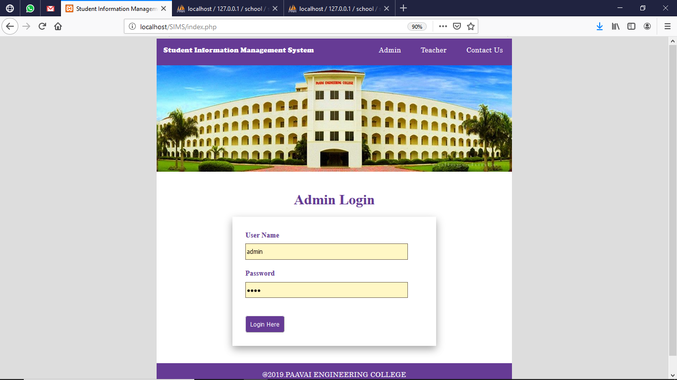
ADMIN LOGIN

Slide 10
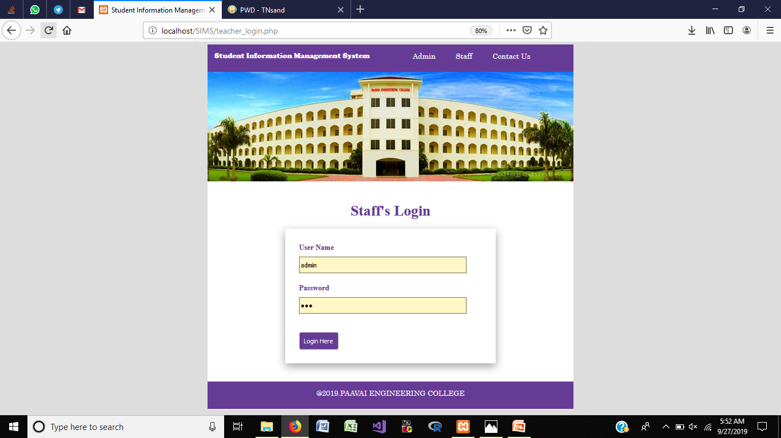
STAFF’S LOGIN

Slide 11
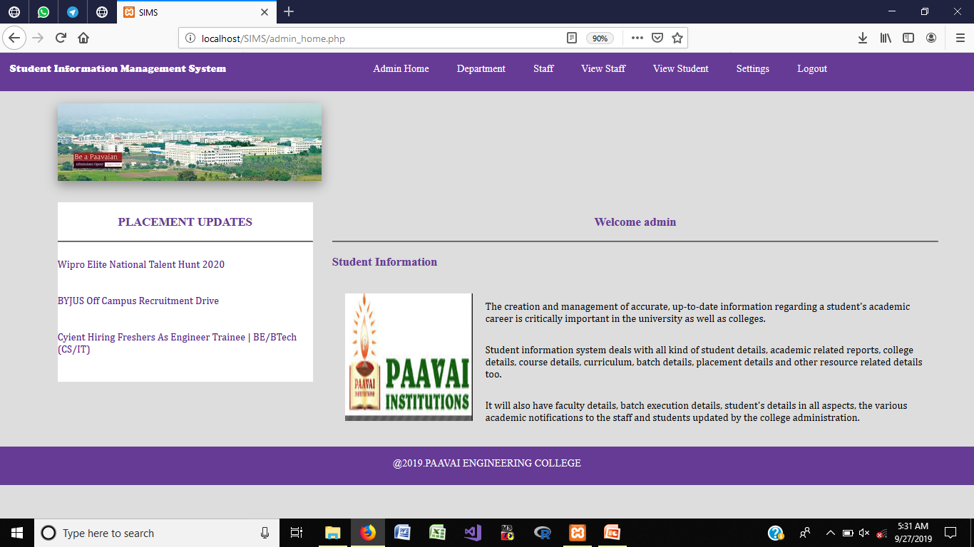
ADMIN HOME PAGE

Slide 12
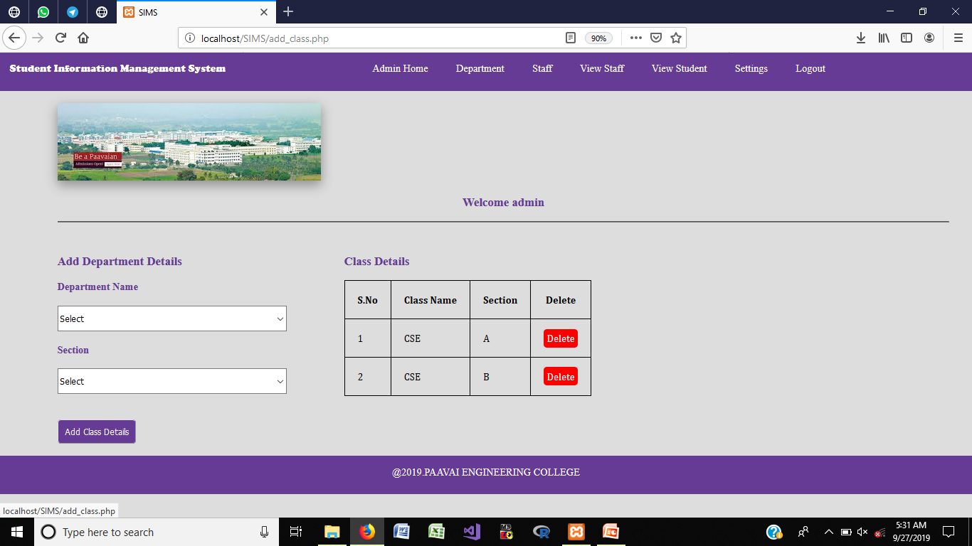
ADD DEPARTMENT

Slide 13
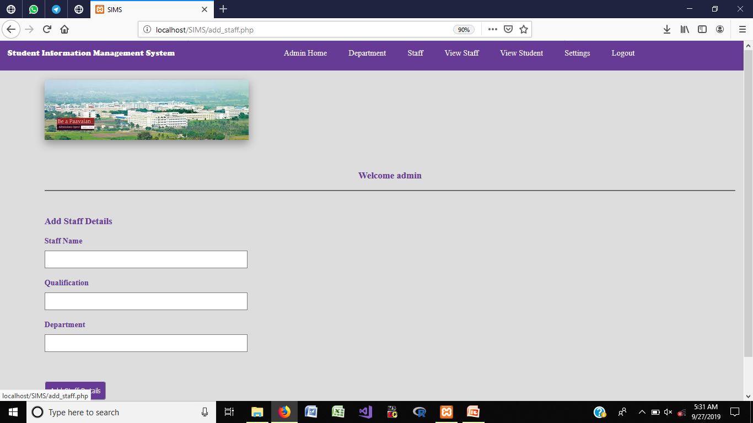
ADD STAFF DETAILS

Slide 14
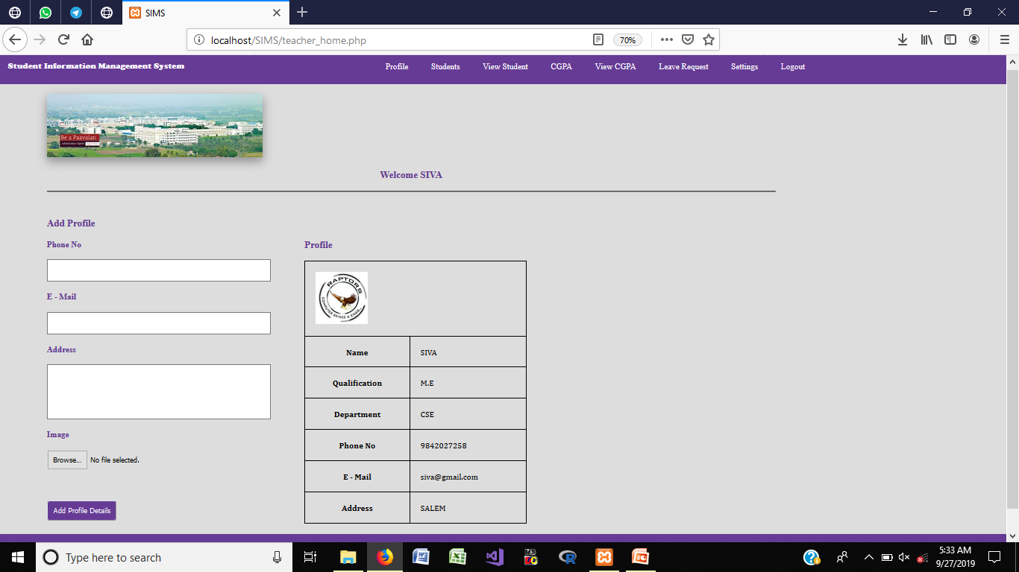
STAFF’S LOGIN - STAFF PROFILE

Slide 15
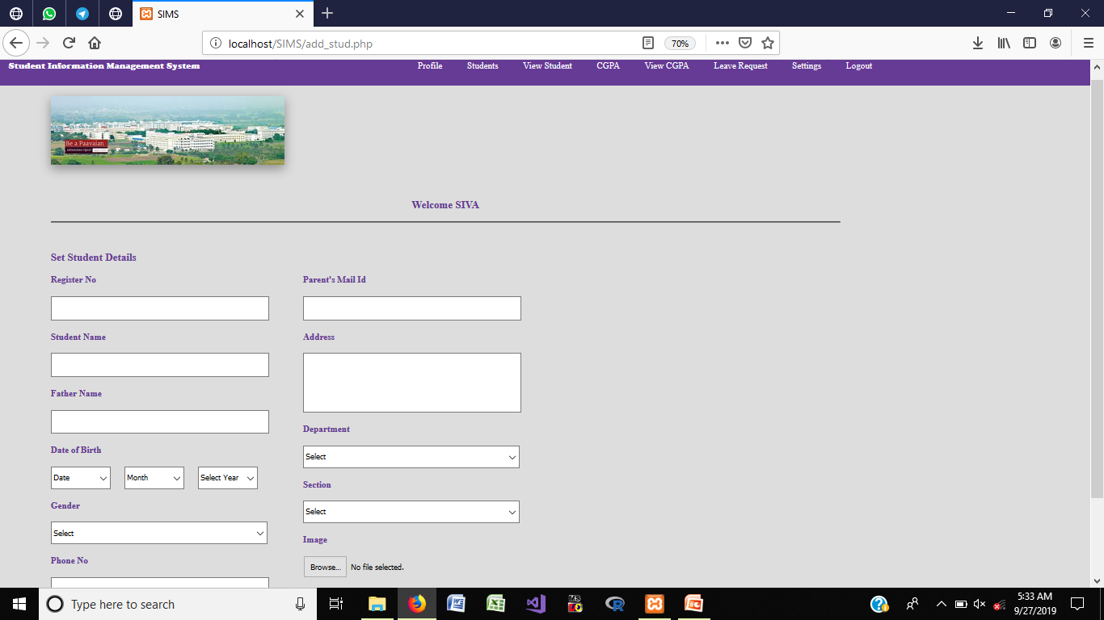
ADD STUDENTS DEATILS

Slide 16
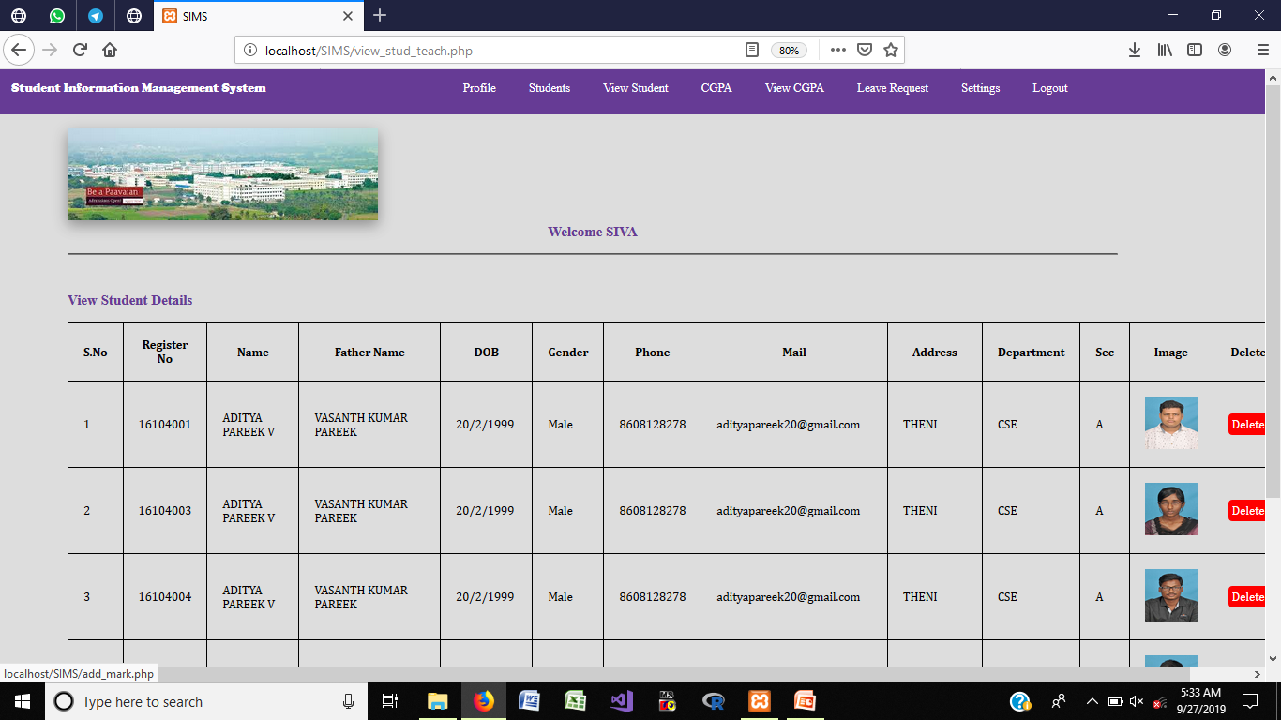
VIEW STUDENTS

Slide 17
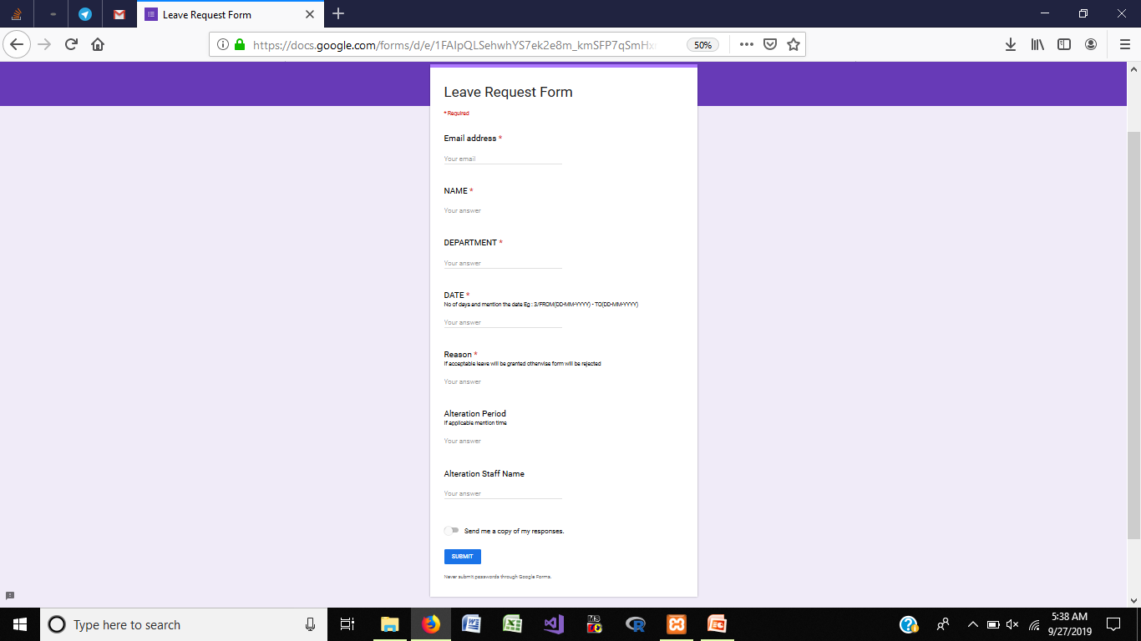
LEAVE REQUEST

Slide 18
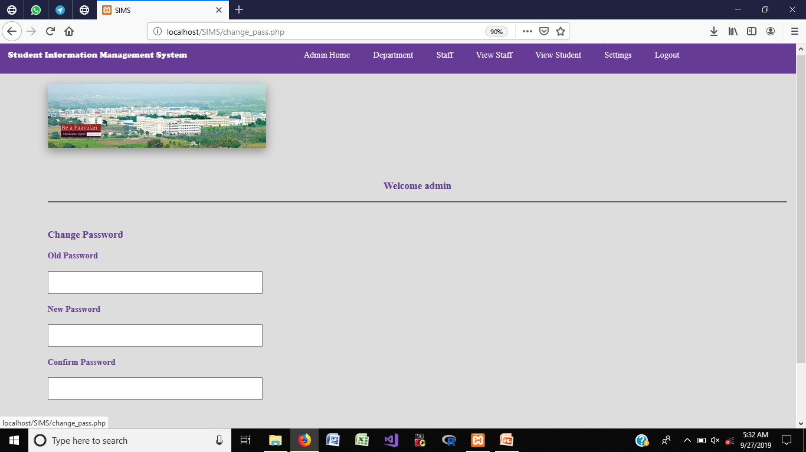
CHANGE PASSWORD

Slide 19
CONCLUSION
Can be accessed any time by using this system.
No wastage of resources in colleges and universities.
Monitored and controlled remotely.
Reduces the man power.
It provides accurate information always.

